Slide 1

HR Resources for
Faculty Recruitment
Fall 2017

Slide 2
Agenda
Recruiting a diverse group
Interfolio
Search Committee Guide
Reports
Advertising
Competencies
Resources for high level searches
Notes:
Courtney's handout

Slide 3
Recruiting a Diverse Pool
Introduce handout: Top 10 Ways to Recruit a Diverse Group of Faculty and Staff
Notes:
Courtney's handout

Slide 4
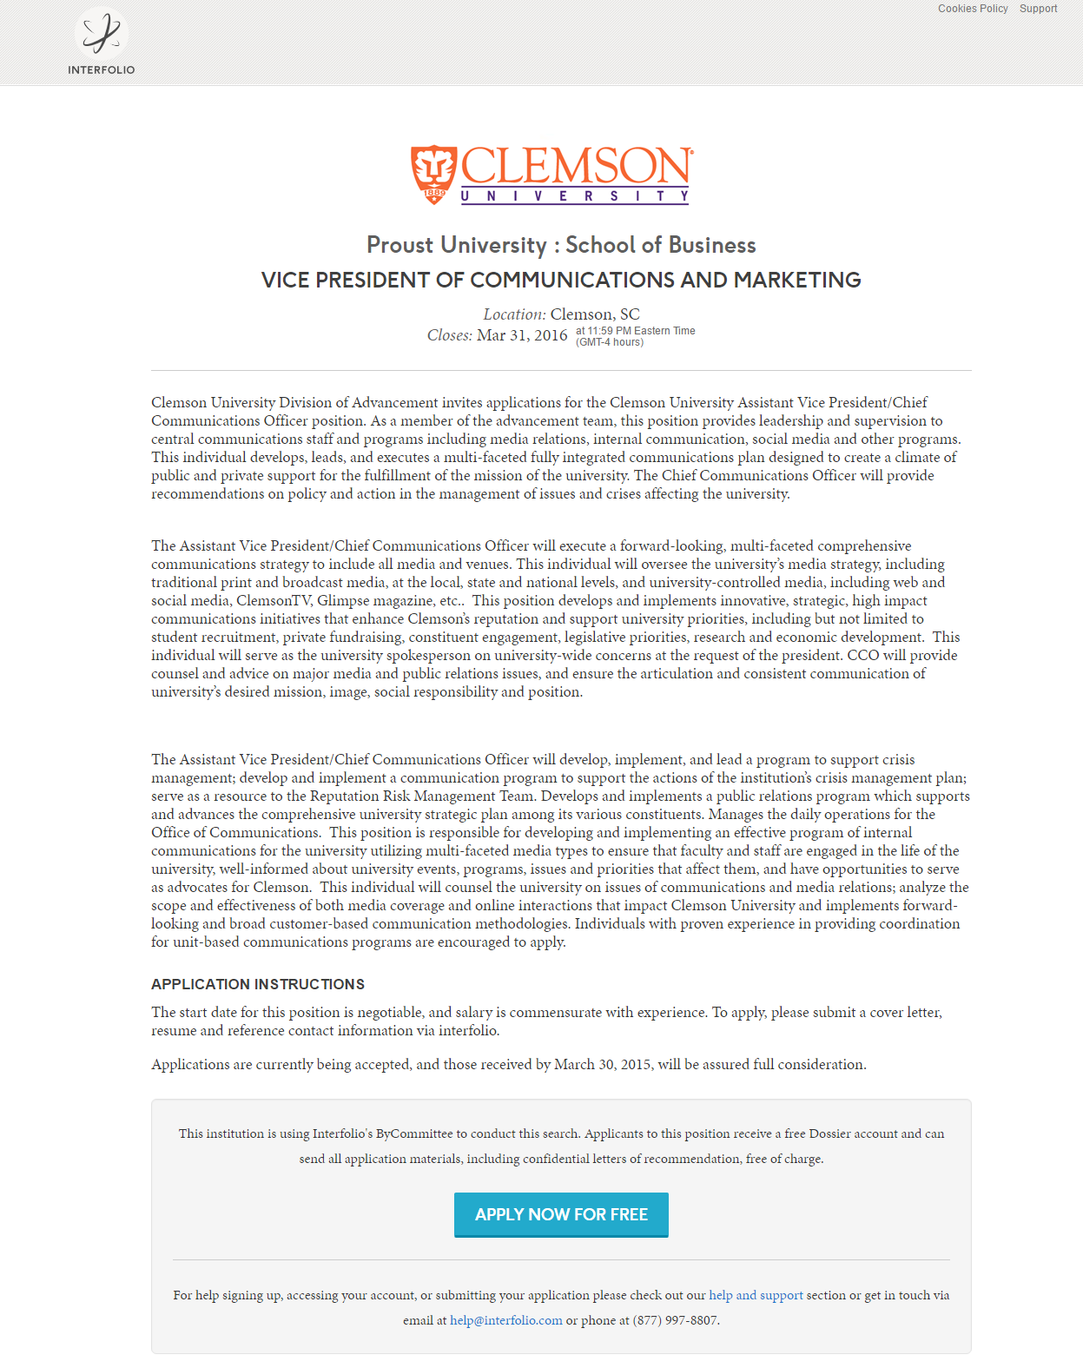
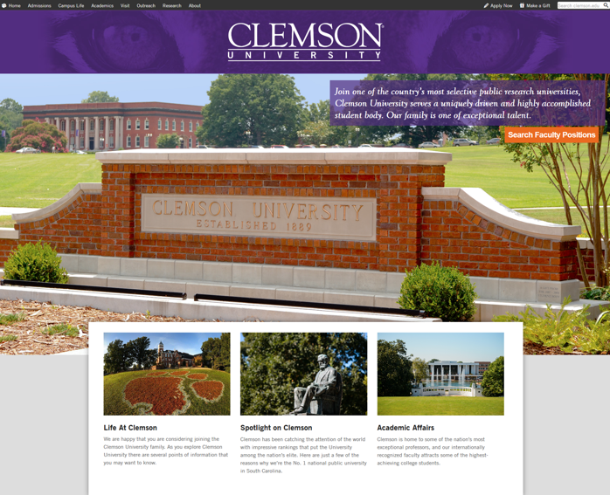
Interfolio
Clemson’s online faculty application system
  Strategic decision to purchase Interfolio, a faculty-specific recruitment tool that works with hundreds of institutions
  Successful migration of faculty recruitment efforts
    New and improved faculty job board and the Interfolio platform
Receiving 60% higher return rate for voluntary reports on diversity, veteran and disability status
Provides on demand diversity reporting

Slide 5
Interfolio Training
Past Training:
  OHR has trained over 150 users
Future Training (in ASB Training Room):
  Tuesday, October 24: 8:30 – 10:30 am
  Thursday, November 9: 2:00 – 4:00 pm
  Thursday, November 9: 8:30 – 10:30 am

Slide 6
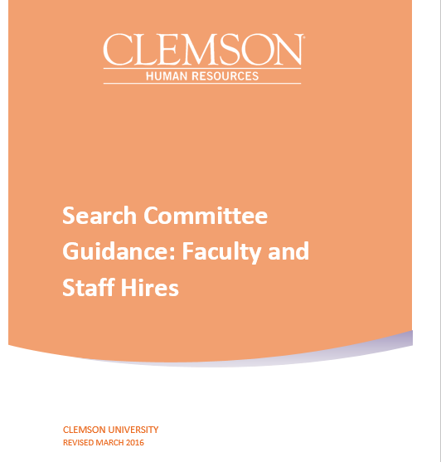
Search Committee Guide
All-inclusive “How To” document for a search committee chair:
Definition of roles
and responsibilities
Confidentiality
Interviewing techniques
Policy
Committee role
Selection and composition
Provides instructions and resources to assist the search committee in their search process
Includes recommendation that a diversity advocate serves on all search committees
  Recruitment planning
  and strategy
  Recruitment and selection
  Request to hire
  Records
  Forms and Other Resources

Slide 7
Diversity Advocate
Each search committee is encouraged to select and designate one individual as a diversity advocate for the committee.
Functions of the diversity advocate:
  Supports the diversity goals of the University and search committee
  Addresses underrepresentation when applicable
  Brings expertise and perspective on diversity to the search
Promoting a diverse and inclusive search process should be the responsibility of all committee members.
Coming soon: Diversity Advocate Certification

Slide 8
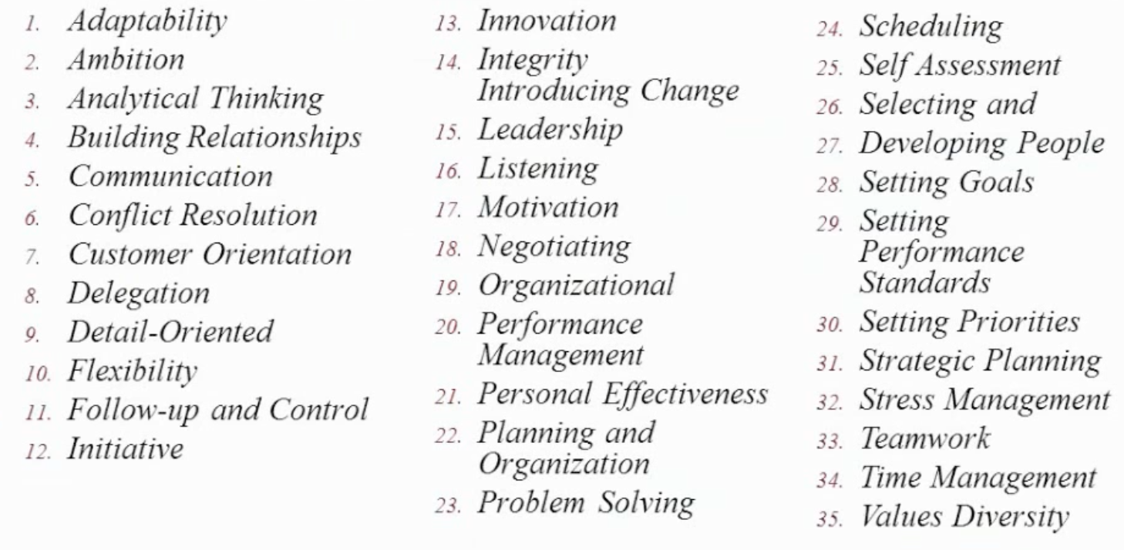
Competencies
Create interview questions to identify the presence of desired competencies
It is important to create competencies to help rate each applicant and eliminate bias.

Slide 9
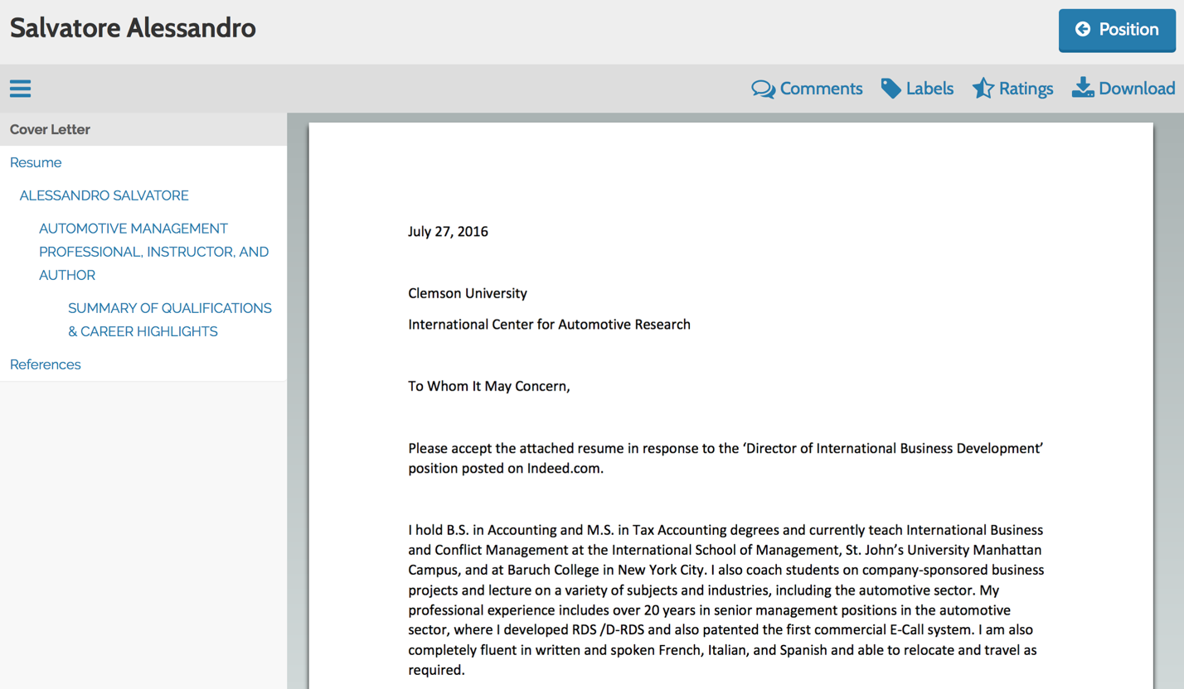
Using Competencies in Interfolio
When reading candidates applications, you can rate each candidate based on predetermined competencies.

Slide 10
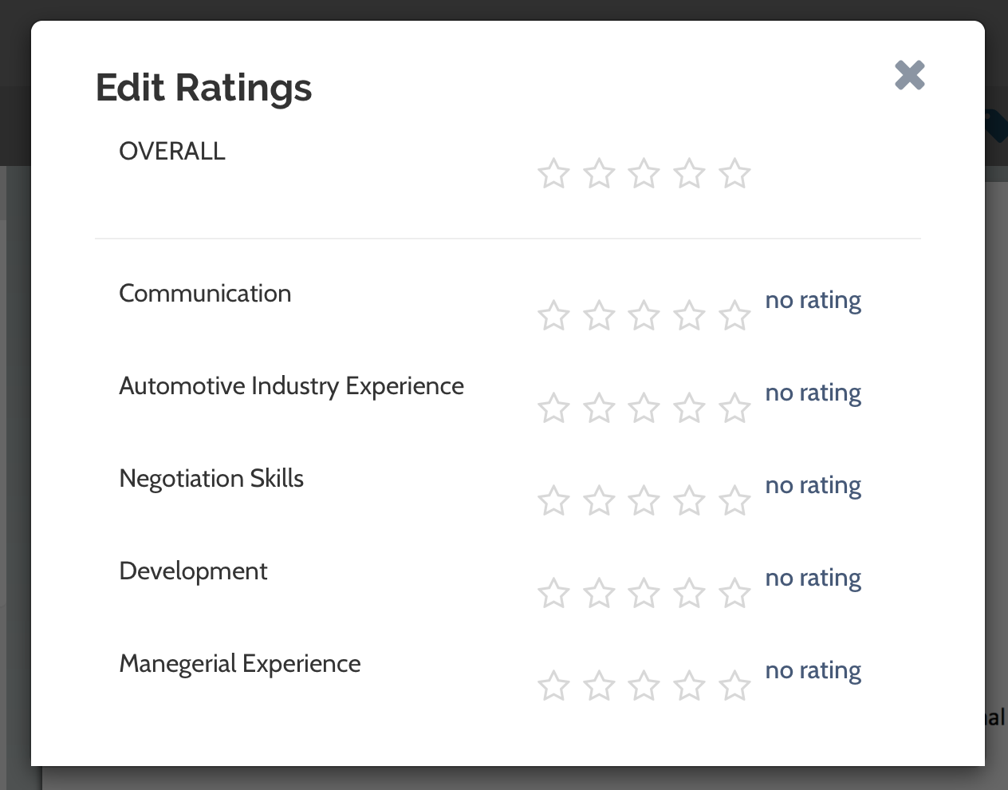
Using Competencies in Interfolio
Allows the rating of each candidate on predetermined competencies using the one to five star rating system.

Slide 11
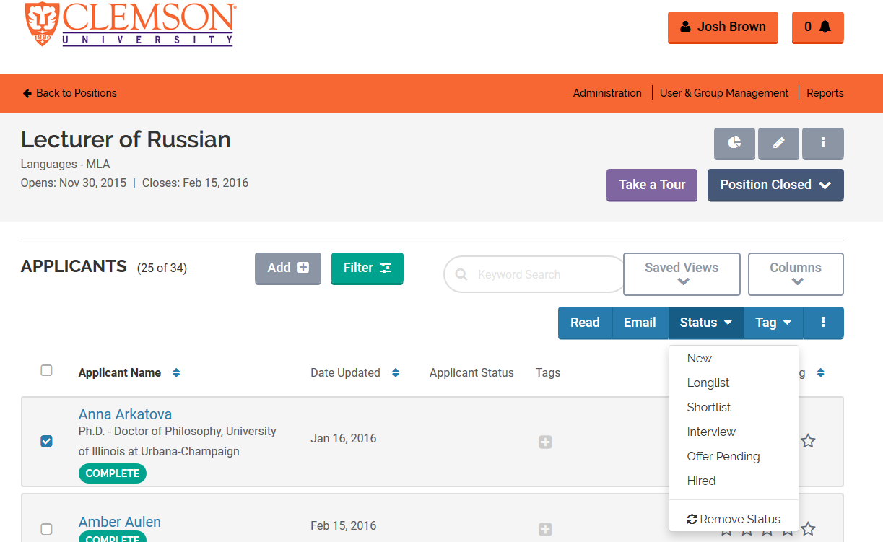
Applicant and Job Statuses
Updating these is critical for the accuracy of EEO and University reporting

Slide 12
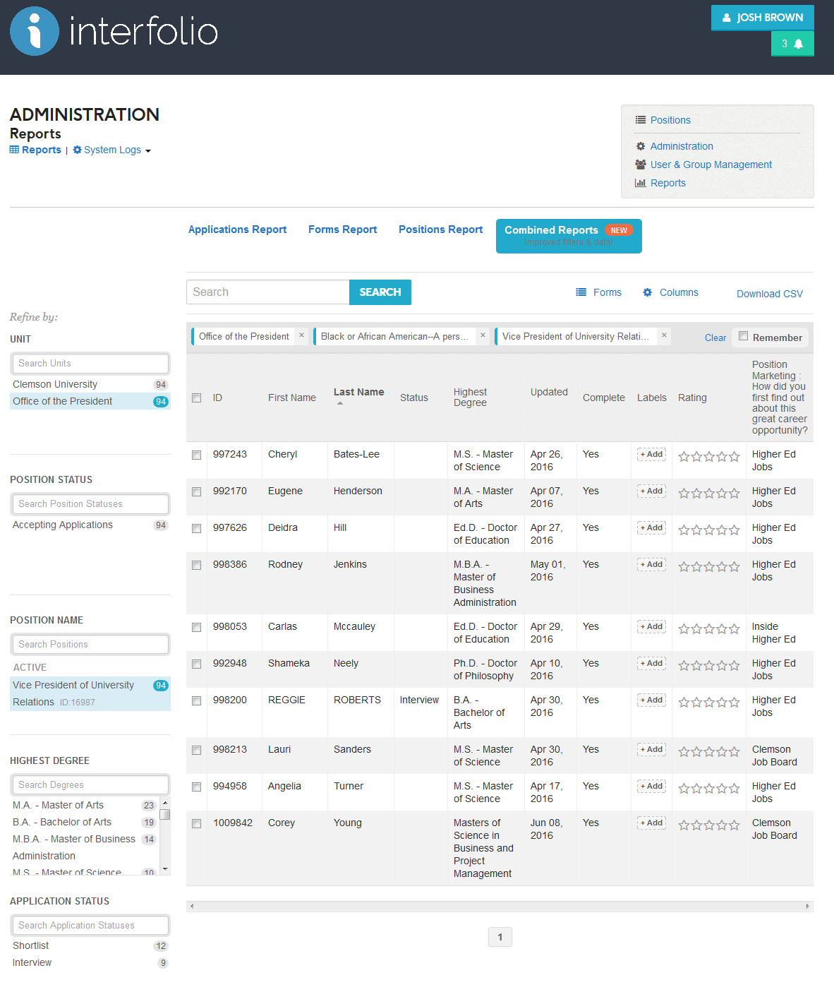
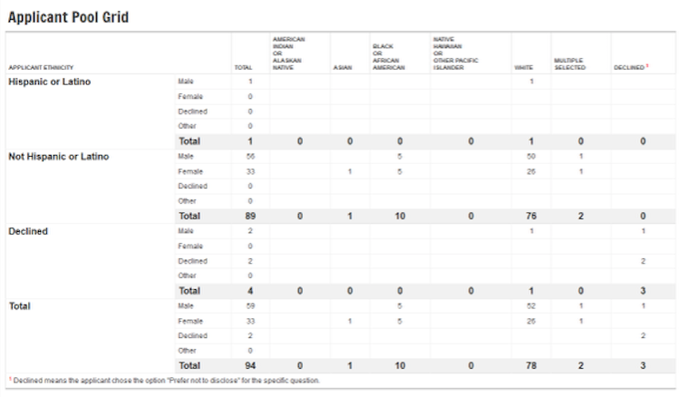
Interfolio: On Demand Reports

Slide 13
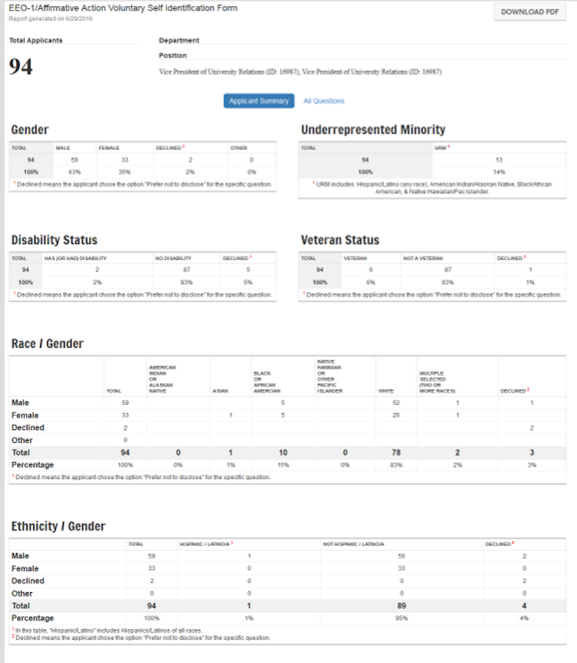
Interfolio: On Demand Reports

Slide 14
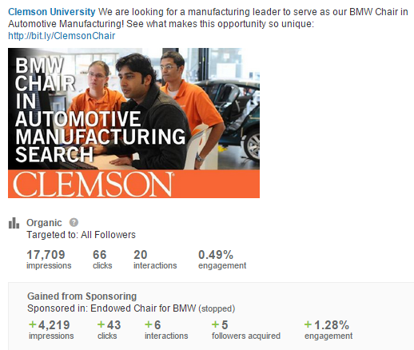
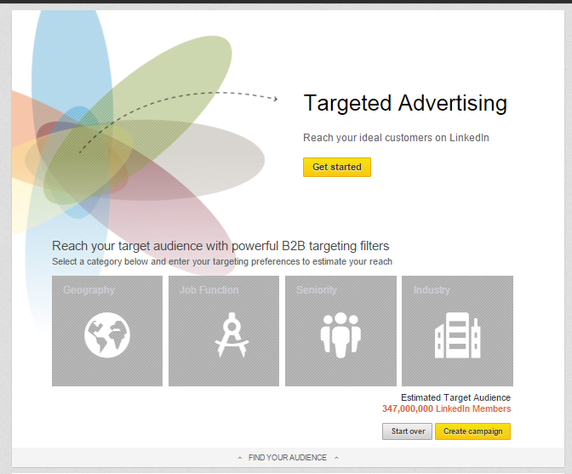
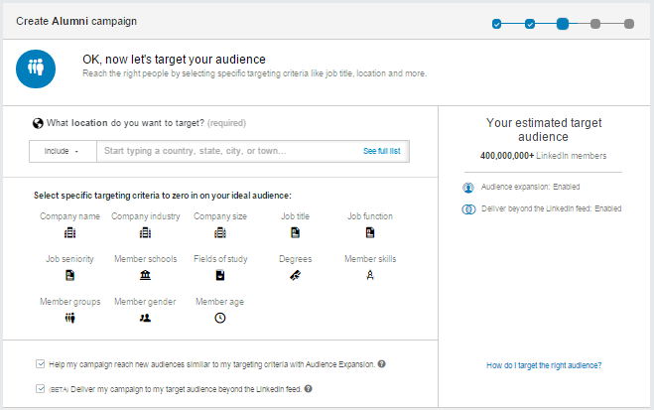
Sponsored Ad

Slide 15
OFCCP Media Packages
All jobs are automatically posted to an OFCCP media package.
  The 8 diversity sites that are automatically distributing our job postings are:
    VetJobs (www.vetjobs.com)
    Veterans Enterprise (www.VeteransEnterprise.com)
    Be A Hero – Hire A Hero (www.beahero-hireahero.com)
    JOFDAV – Job Opportunities for Disabled American Veterans (www.jofdav.com)
    Disabled Person (www.disabledperson.com)
    The Black Perspective (www.blackperspective.com)
    Hispanic Today (www.hispanic-today.com)
    Women in Business & Industry (www.wib-i.com)
    HERC (https://www.hercjobs.org/)
Categories of job sites include: Diversity, Veterans, Disability, and State Job Board.
OHR highly encourages recruiters to choose from one of the discounted marketing packages listed in the Recruitment Advertising Guide.
Notes:
From CLEMSONFORWARD plan: “Increase Diversity: A more diverse student body, faculty and staff are fundamental to Clemson’s ability to provide educational experiences that prepare graduates to thrive in 21st century workplaces and communities. ClemsonForward enhances resources for the recruitment and retention of top talent from all racial groups and socioeconomic backgrounds. Specific investments include additional funds for student scholarships and for increased diversity of students and faculty applicant pools along with development programs that expand diversity among both the faculty and the senior levels of the staff.”

Slide 16
Additional Clemson Resources
HR Partners
Confidentiality agreement template
Offer letter template
Search Committee Guide
Prove-It skill assessment
Skill survey
Interview evaluation template
Sample interview questions
Coming Soon
  Employer branding templates
  Standardized professional marketing

Slide 17

Spousal/Partner Career Assistance Program
78 Individuals since 2014
41 Hired since
23 Actively Assisting
Notes:
Clemson University offers spousal/partner career assistance in support of the University’s efforts to recruit and retain the most qualified faculty, staff and administrators. Upon request, Clemson University’s Office of Human Resources provides up to six months of customized job search assistance to spouses/partners of qualified new hires facing a dual career challenge. The assistance includes:
• Pre-offer spousal or partner consultations during recruitment
• Cover letter and resume/curriculum vitae critique
• Introductory letter to external employers or hiring departments at the University
• Guidance on interviewing techniques and salary negotiations assistance
• Job board visibility assistance (we search for jobs and send openings to candidates on a bi-monthly basis)
• Bi-monthly, skill-specific job recommendations
• Recommendations/referrals from the OHR recruitment team

Slide 18
Resources for High Level Searches
Recruitment proposal
  Details of recruiting plans
  Prospectus and aggressive recruiting tactics
Preliminary candidate compilation
  Results of search
  Electronic candidate application materials
Phone interviews
  Screening questions
  Interview questions
Airport Interviews
  SkillSurvey reference check
  360 candidate comparison report
  Interview questions
Final on-campus interviews
  Schedule of events
Informs
Standardizes
Organizes

Slide 19
Q & A
Notes:
Clemson University offers spousal/partner career assistance in support of the University’s efforts to recruit and retain the most qualified faculty, staff and administrators. Upon request, Clemson University’s Office of Human Resources provides up to six months of customized job search assistance to spouses/partners of qualified new hires facing a dual career challenge. The assistance includes:
• Pre-offer spousal or partner consultations during recruitment
• Cover letter and resume/curriculum vitae critique
• Introductory letter to external employers or hiring departments at the University
• Guidance on interviewing techniques and salary negotiations assistance
• Job board visibility assistance (we search for jobs and send openings to candidates on a bi-monthly basis)
• Bi-monthly, skill-specific job recommendations
• Recommendations/referrals from the OHR recruitment team

